Slide 1



Meta Quest
Microsoft Mesh
Bundles

Slide 2

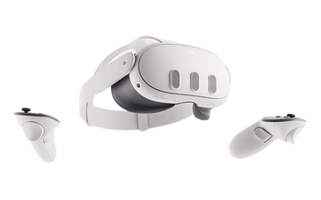


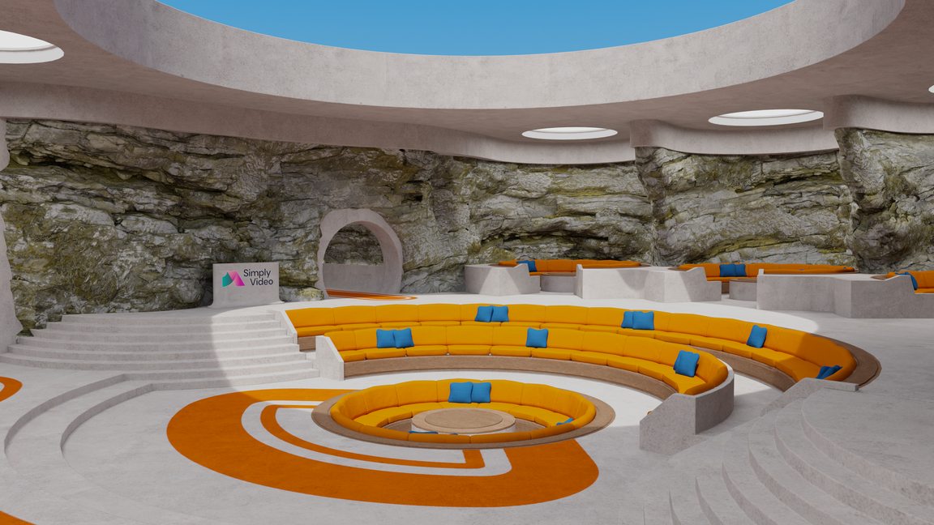
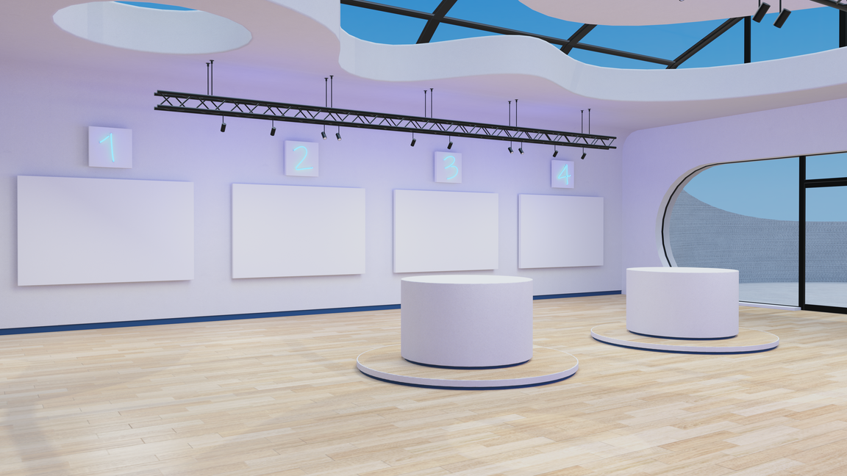
Chat X Bot support
Implementation
Maintenance subscription
3 Years
Meta Quest 3 Headsets
Meta Quest
Microsoft Mesh
Meta for Business
Multiple device management Software
Bundles
Microsoft Mesh
- Bespoke Branded Auditorium room
Microsoft Mesh
- Bespoke Branded Training room

Slide 3
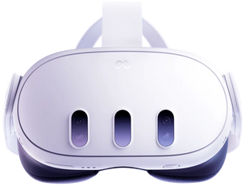
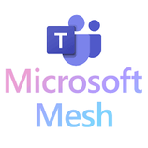
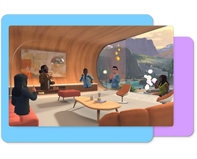


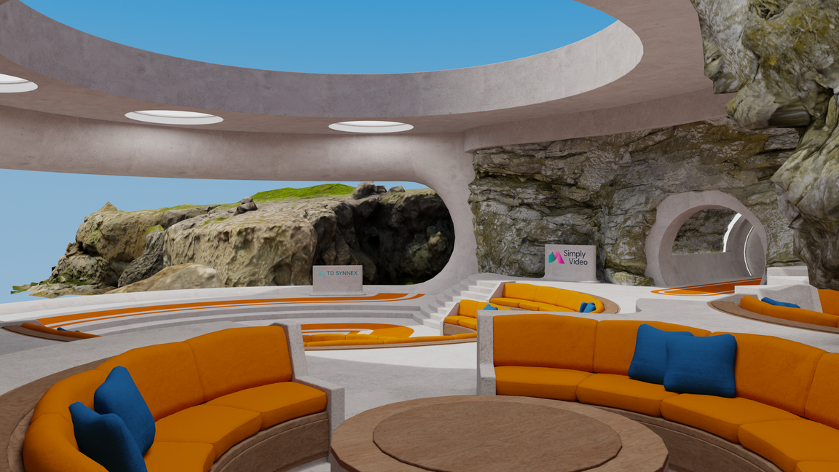
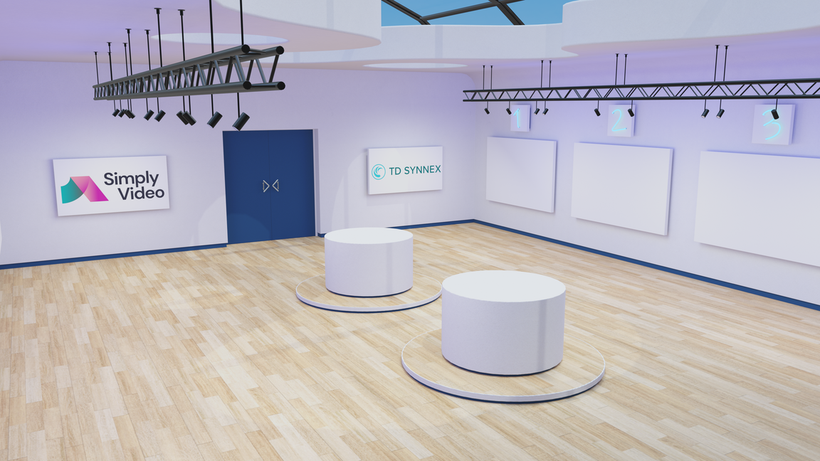
META QUEST AND MESH BUNDLES
Included:
STARTER
SILVER
GOLD
Meta Quest 3S (128GB)
3
5
5
Custom Branded Auditorium
1
1
1
Your Logo
Additional room/scenes
2
5
Your Brands Colourways
License length
3 Years
3 Years
3 Years
Developed in Unity
Cost
£4,000
£6,000
£10,000
Setup and training
1 Day
1 Day
2 Days
Support
Email/ChatBot
Email/ChatBot
Email/ChatBot
Bespoke Auditorium
Branded Presentation Room
  Custom-made Microsoft Mesh Rooms
  Developed to Your Specification
  In Unity
  Release to your domain

Slide 4
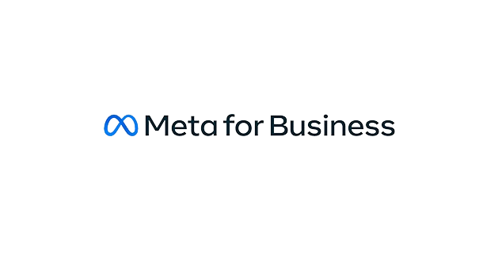
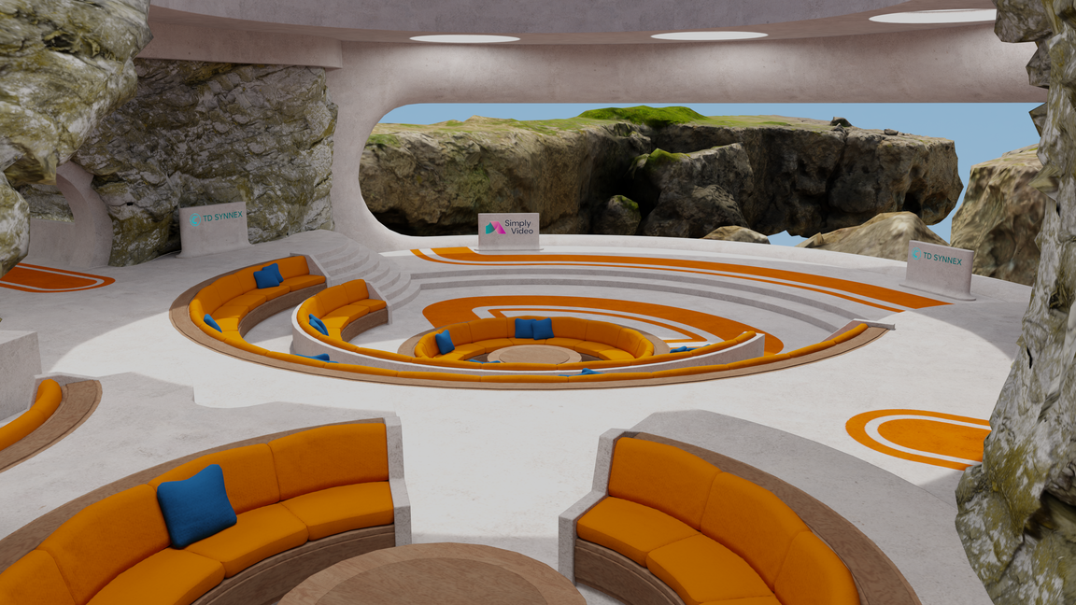

META QUEST AND MESH BUNDLES
Mobile Device Management
STARTER
SILVER
GOLD
3
5
5
Meta for business licenses
Meta for business cost per month*
£36
£60
£60
Implementation and maintenance
£150 Per Month
£150 Per Month
£150 Per Month
Additional room/scenes
£2,000
£2,000
£2,000
AI Chatbot access
POA
POA
POA
Live data feeds
POA
POA
POA
Example of an
additional room scene
*1 Year Meta for Business included
Meta for Business gives
you Mobile device policy management

Slide 5
META QUEST & MESH BUNDLES
Typical use cases for Meta Quest and Micrsoft Mesh solutions
Use cases
STARTER
SILVER
GOLD
All hands meetings
Town halls
Onboarding and induction
Learning and development
Digital twin
Virtual showroom
Retail insight
*1 Year Meta for Business included

Slide 6


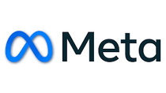

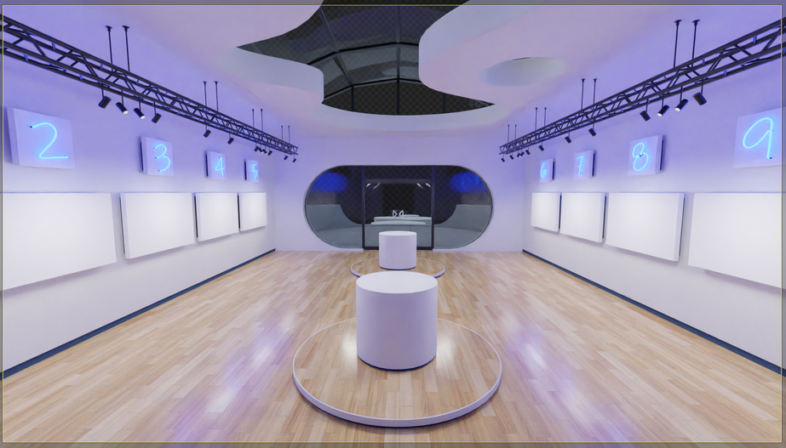
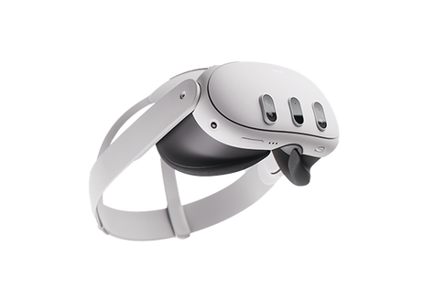


Meta Quest 3 X Microsoft Mesh offer
Meta Quest 3
Microsoft Mesh
Offer
1. Sign up for demo
2. Recieve Meta Quest 3
3. Book a demo
4. Order your Meta and
Microsoft mesh package
5. Keep the headset
Upgrade you Employee Engagement and Productivity to unlock better Performance
Book your
demonstration

